Slide 1
Mental Health in NZ
Damian Sastre.
Menglong Shi.

Slide 2




Background
Mental health has become an important topic in the last few years.
Global Pandemic increased the attention for politicians to act.

Slide 3
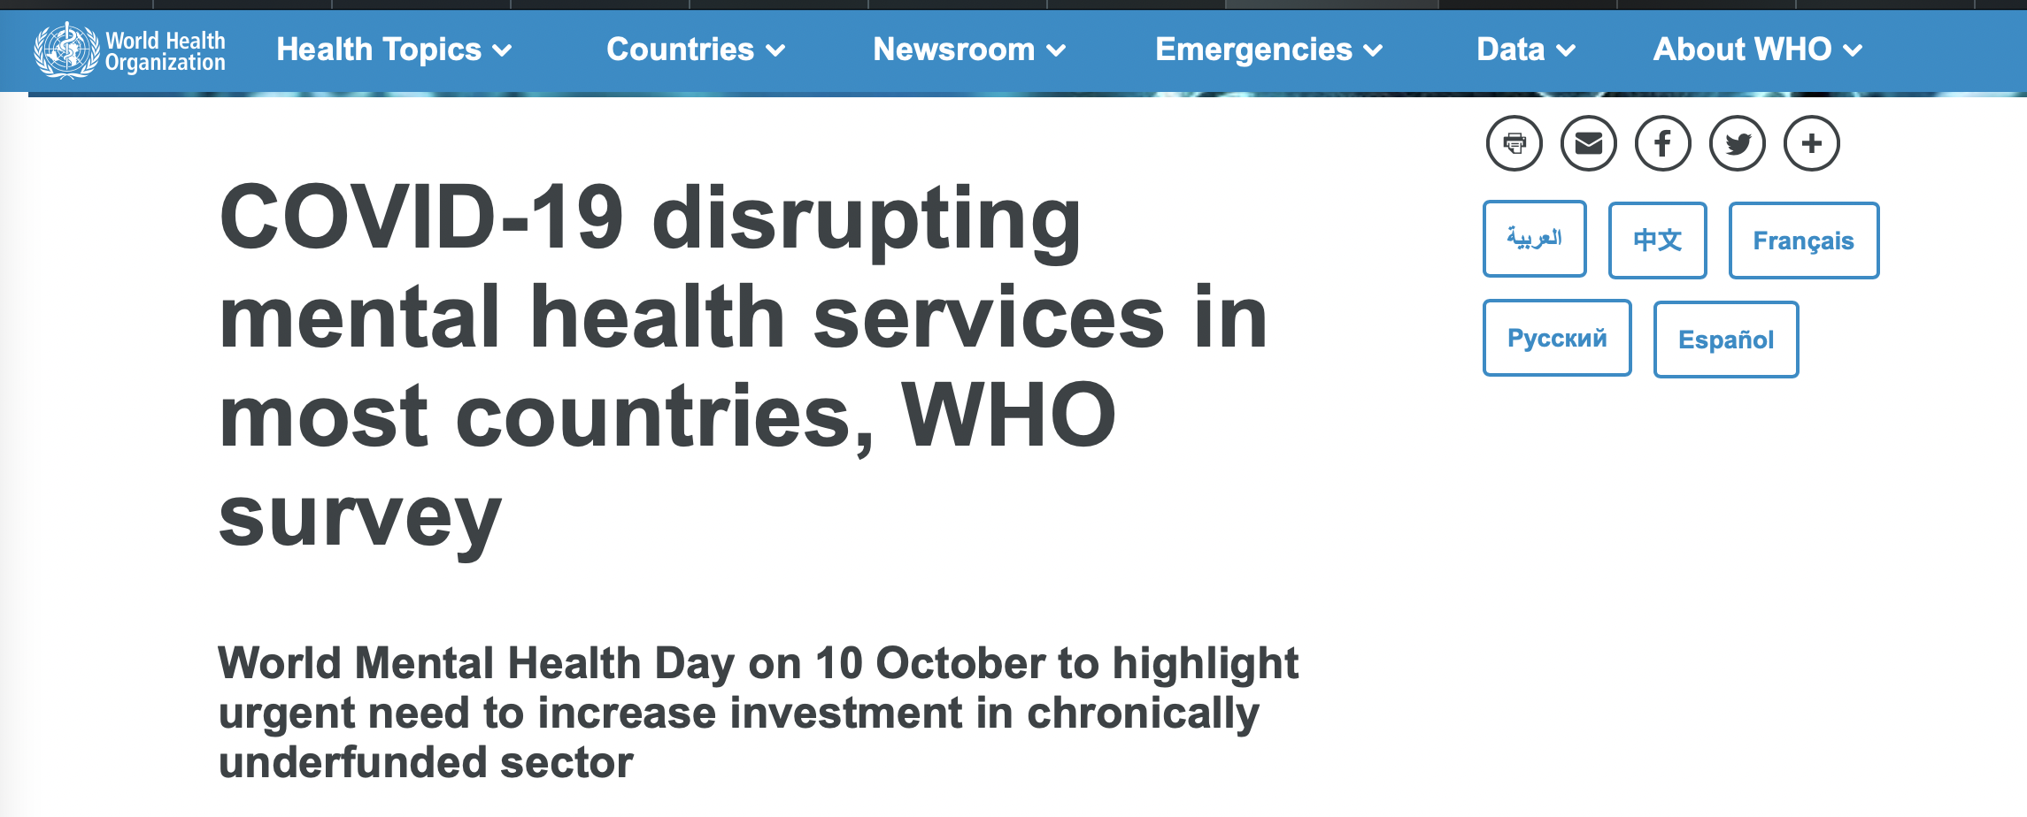

Slide 4

Source of Data.
New Zealand Ministry of Health
Annual Mental Health service Reports since 2002.
Information about service usage.
Age, Gender, Ethnic Group.
Service Usage per Region.
Type of service (Depression, Addiction, etc.)

Slide 5

The Wrangle
Multi Sheet Excel Files
Key information spread over multiple sheets.
Changing format every few years.

Slide 6

Our Approach.
Unify sources of information.
Continuous access to incremental datasets.
Provide a full dataset.

Slide 7

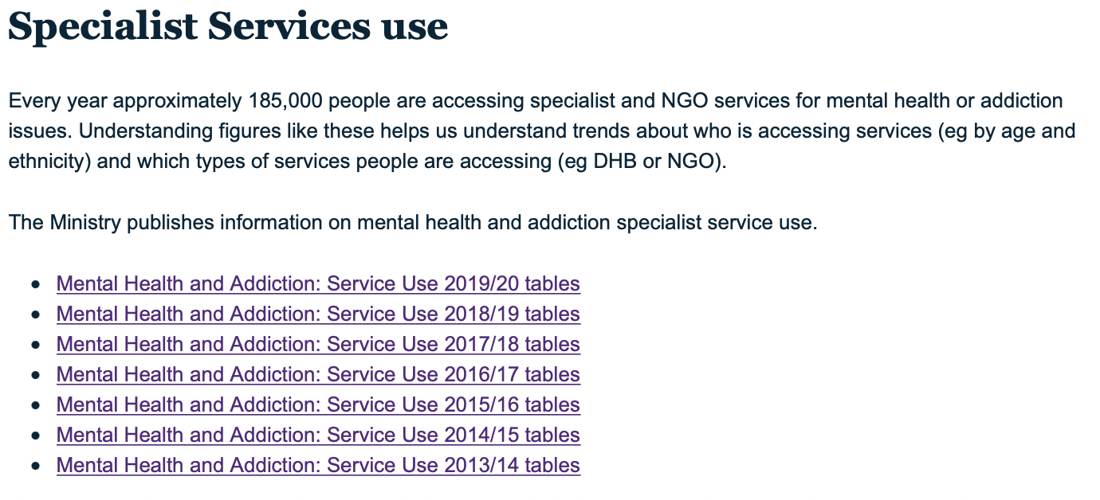
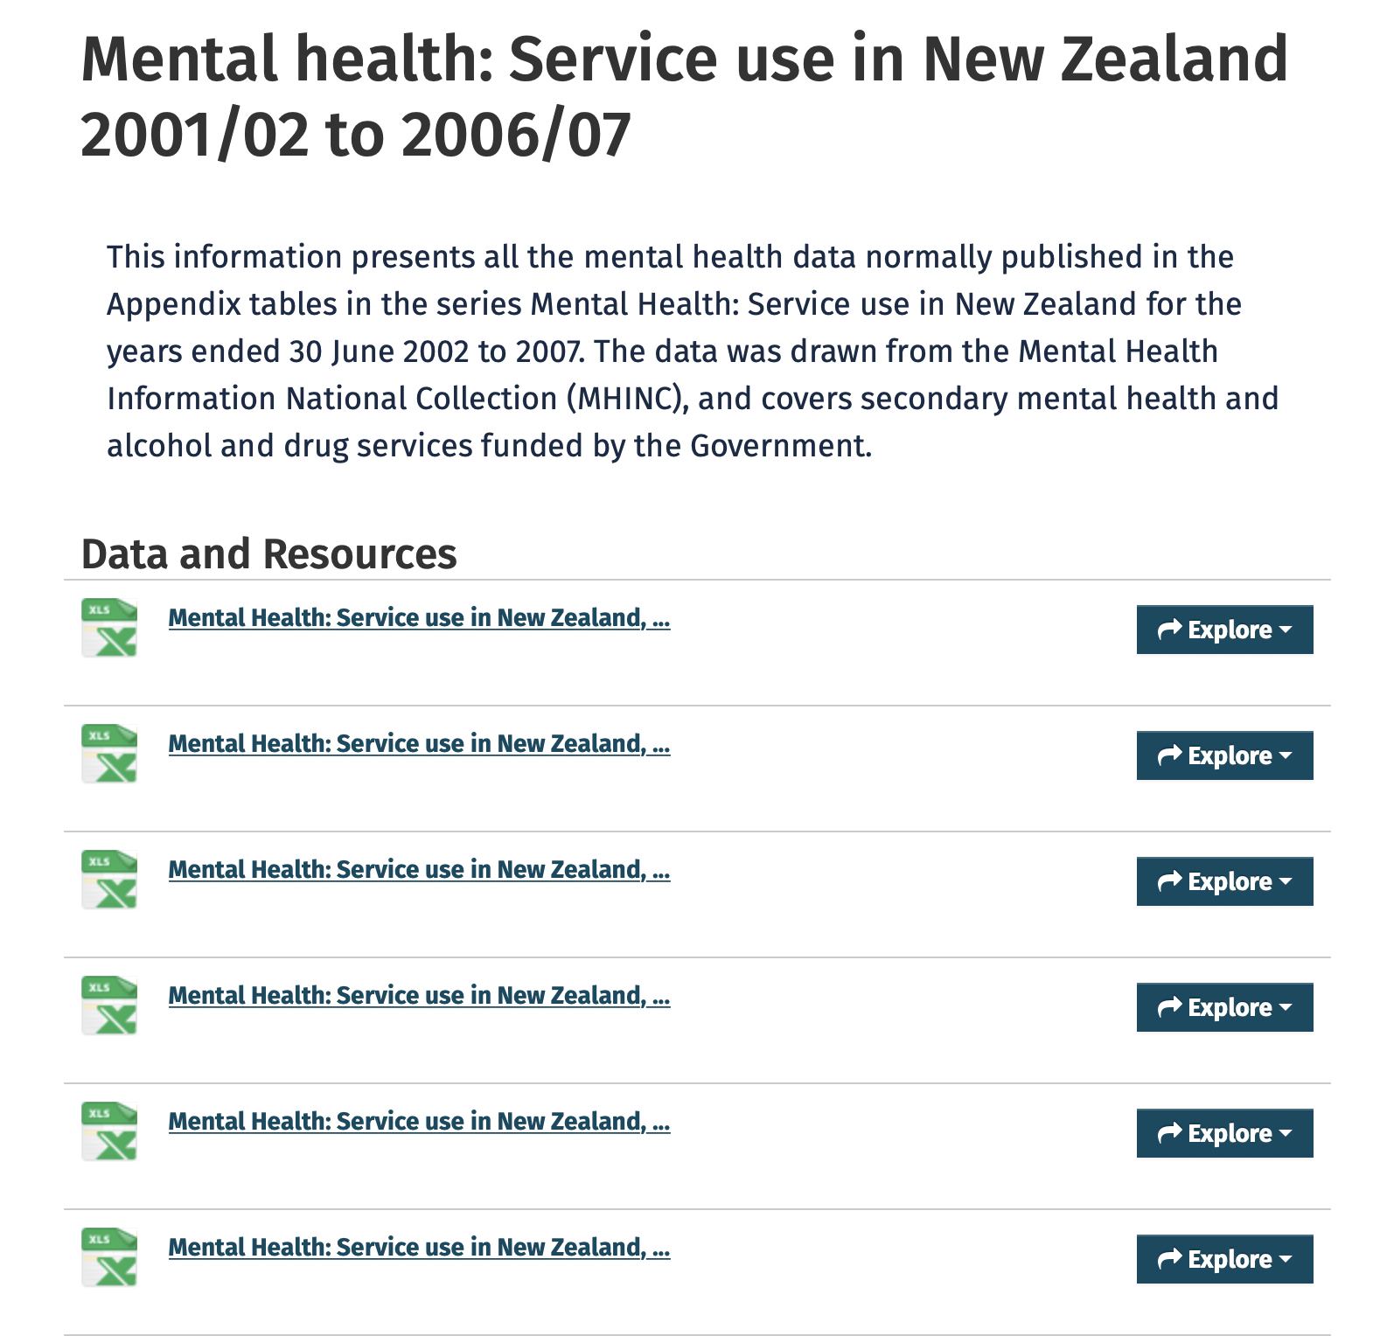

Download all the files!

Slide 8
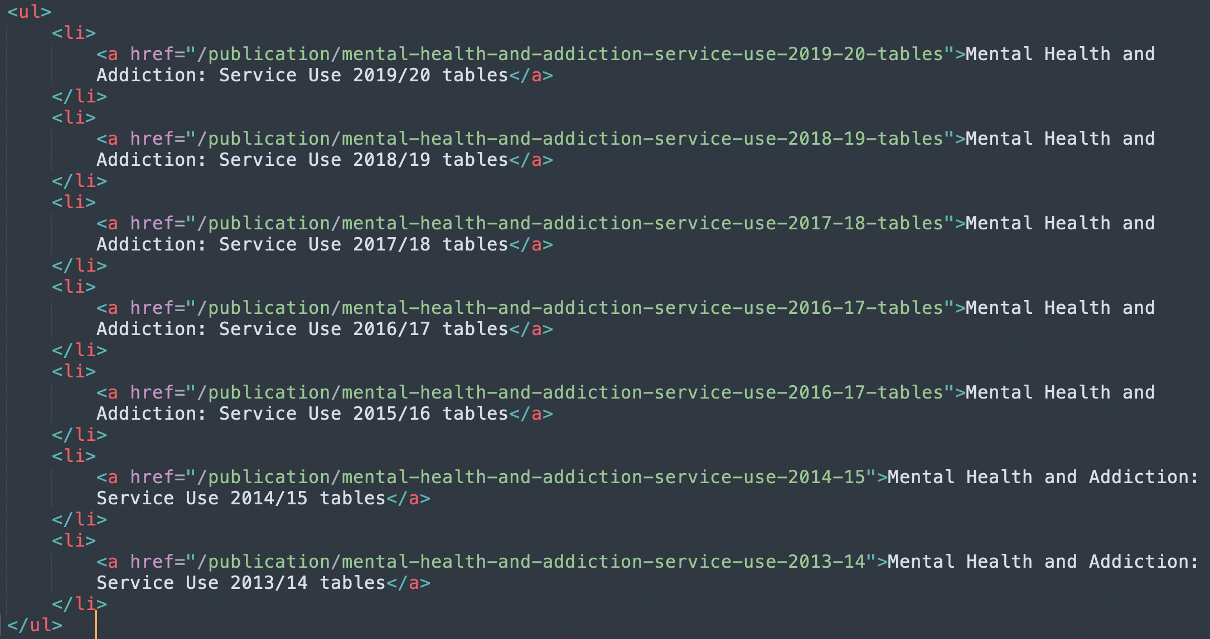
The DOM

Slide 9
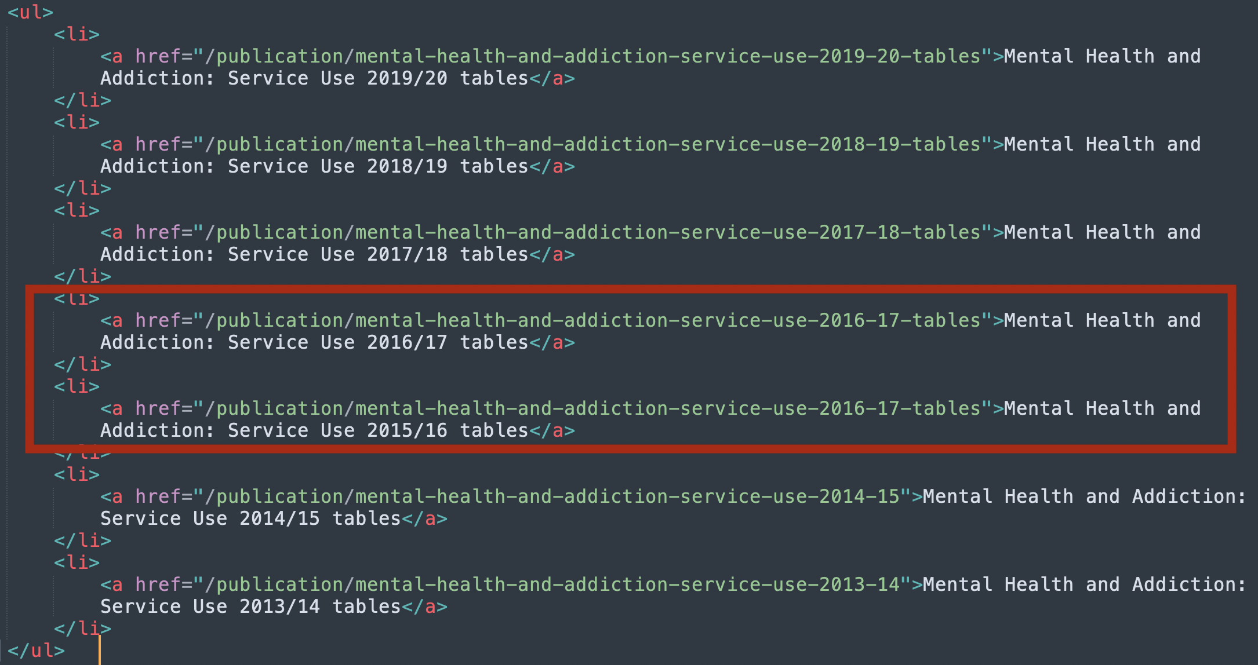
Our First Problem.

Slide 10

Cleaning the Files.
Cell format changed over the years
Multi cell values
Titles not matching over the years
Categories changing name
Naming conventions almost non-existent.

Slide 11
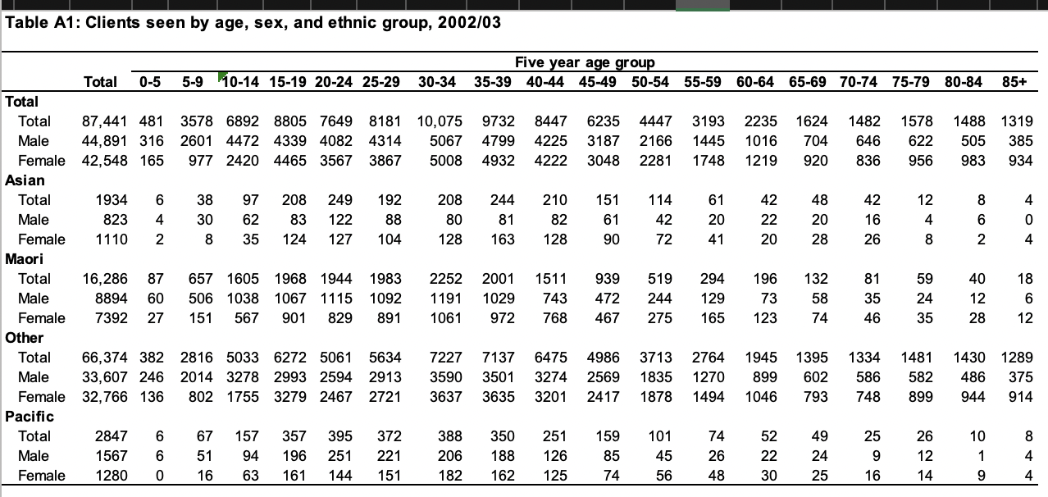
Analyzing the data 1.0

Slide 12
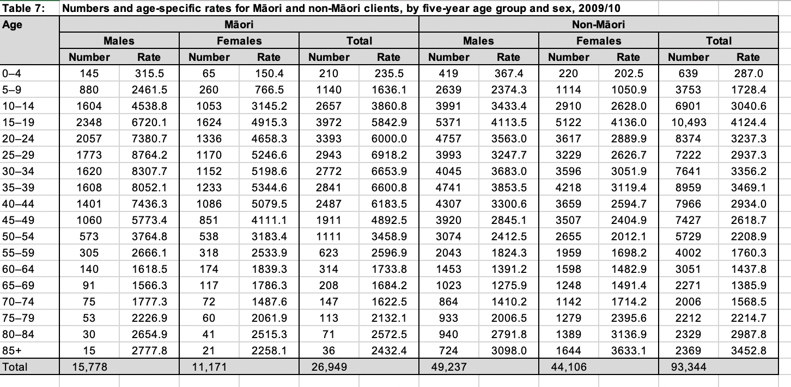
Analyzing the data 1.1

Slide 13
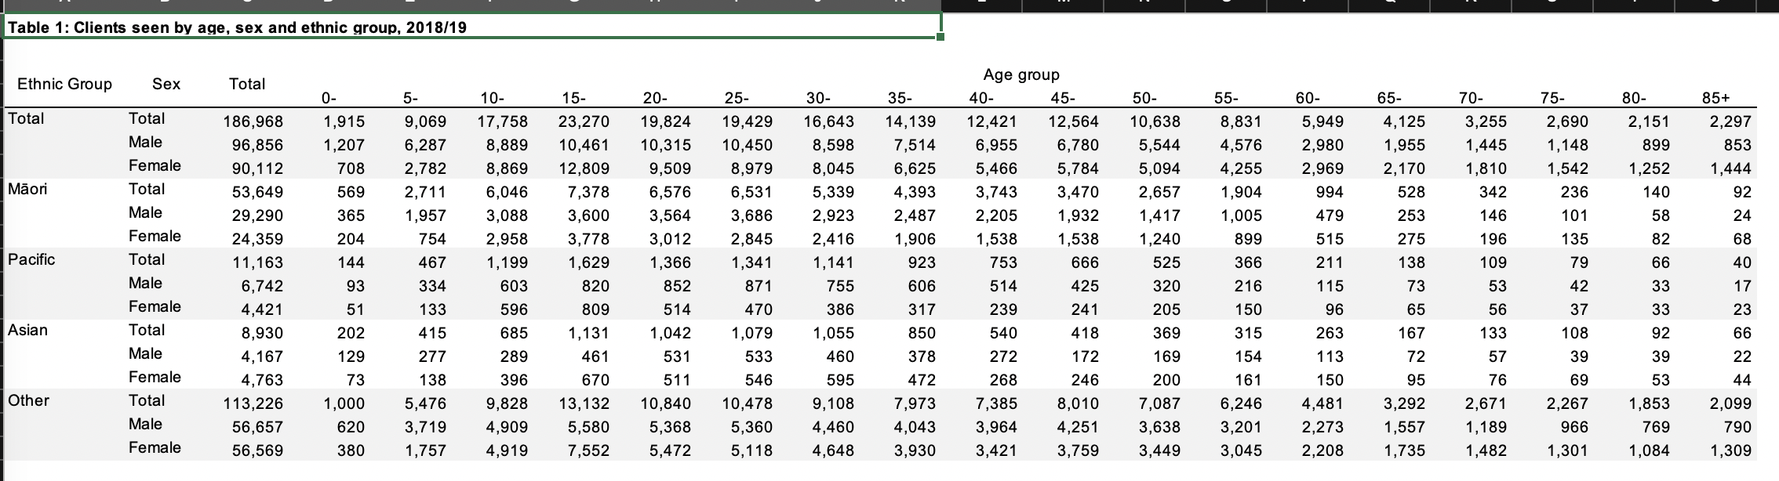
Analyzing the data 1.2

Slide 14
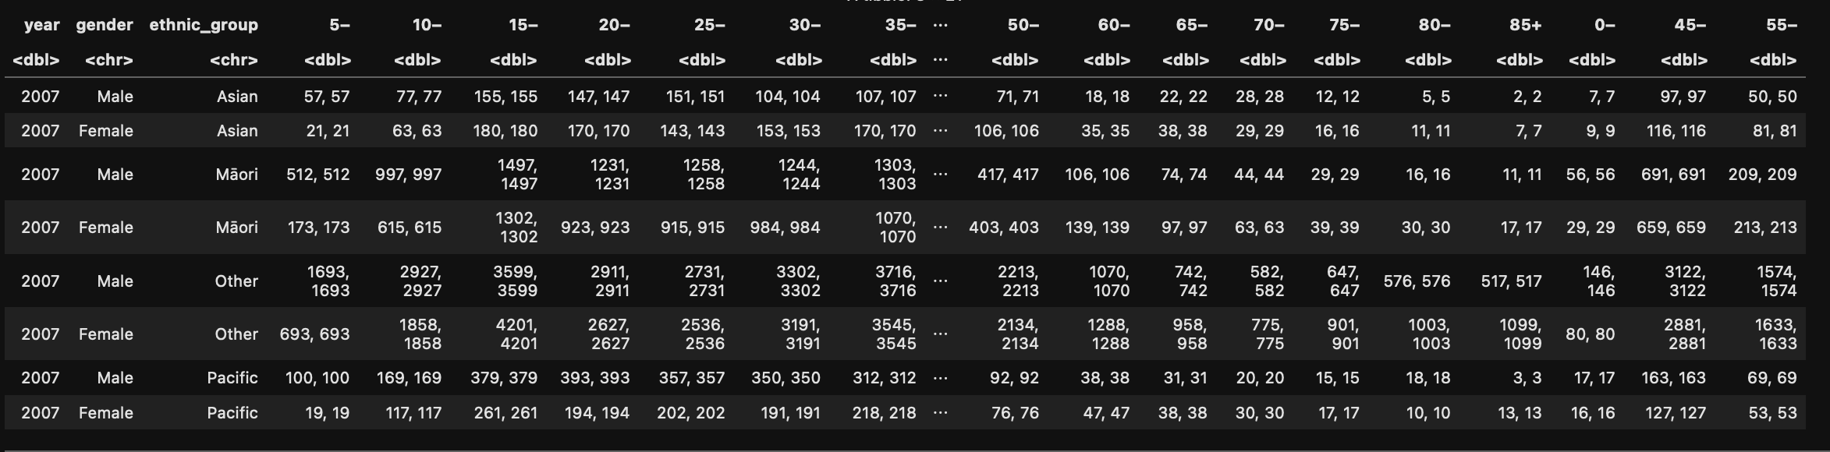
Our first Wide Dataset.

Slide 15
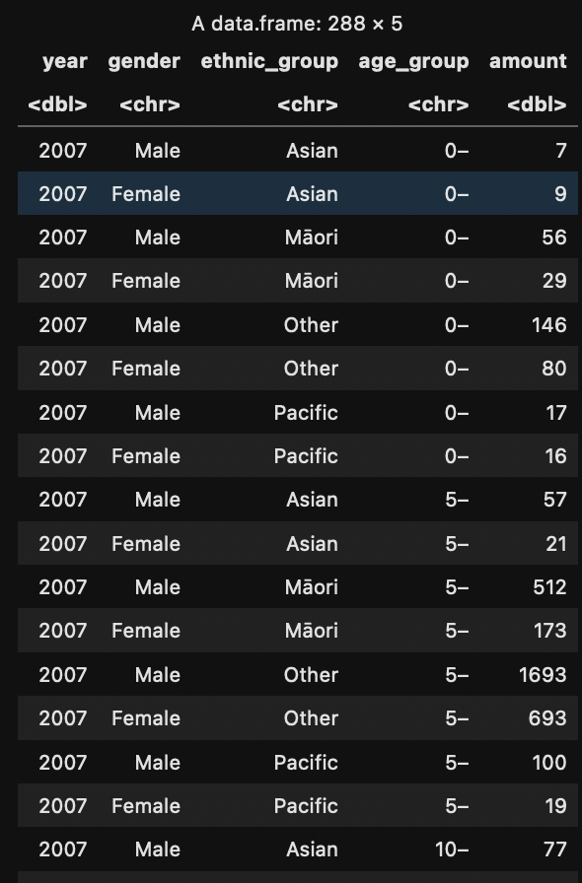
Our first Long Dataset

Slide 16
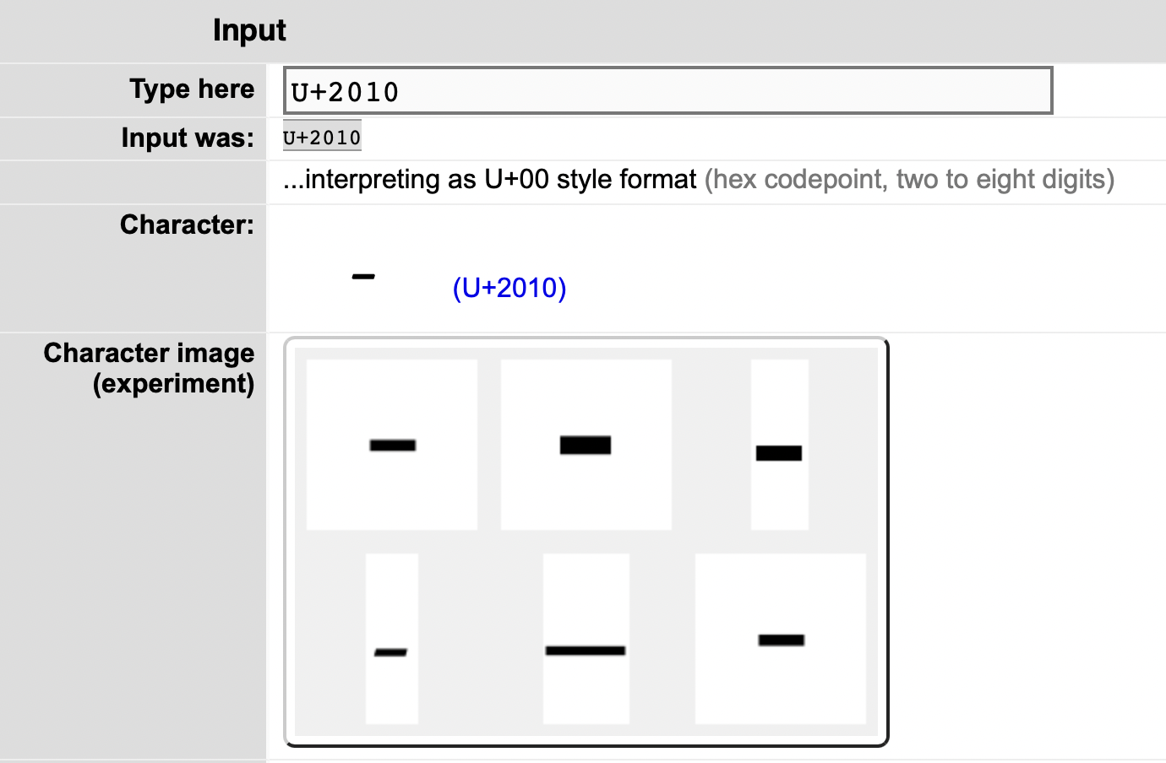
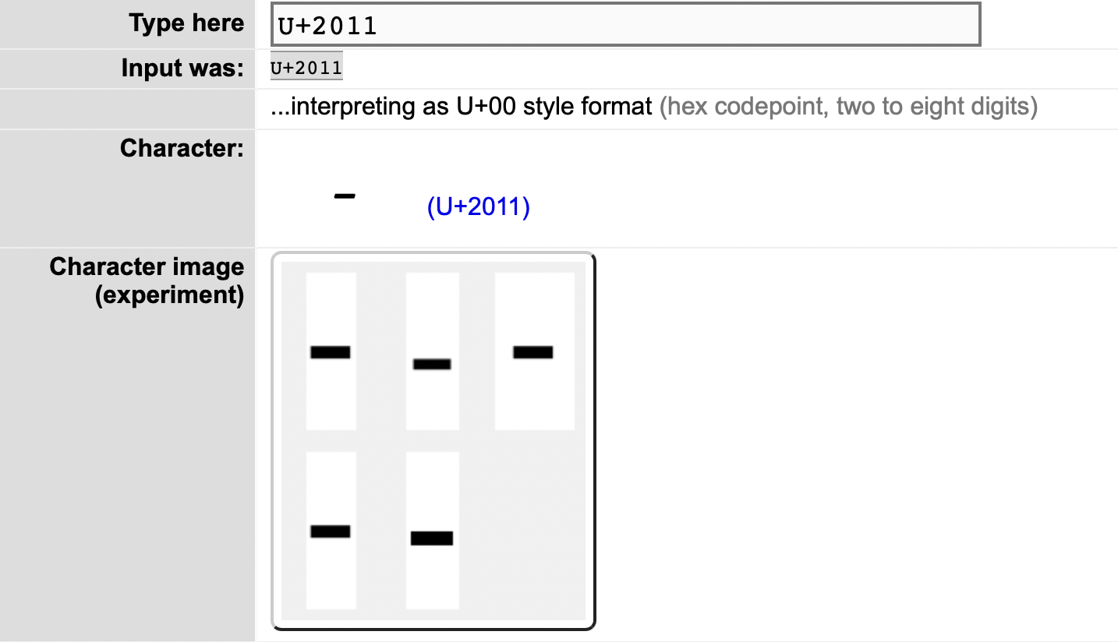
Important Note: NOT THE SAME.
HYPHEN
NON-BREAKING-HYPHEN

Slide 17
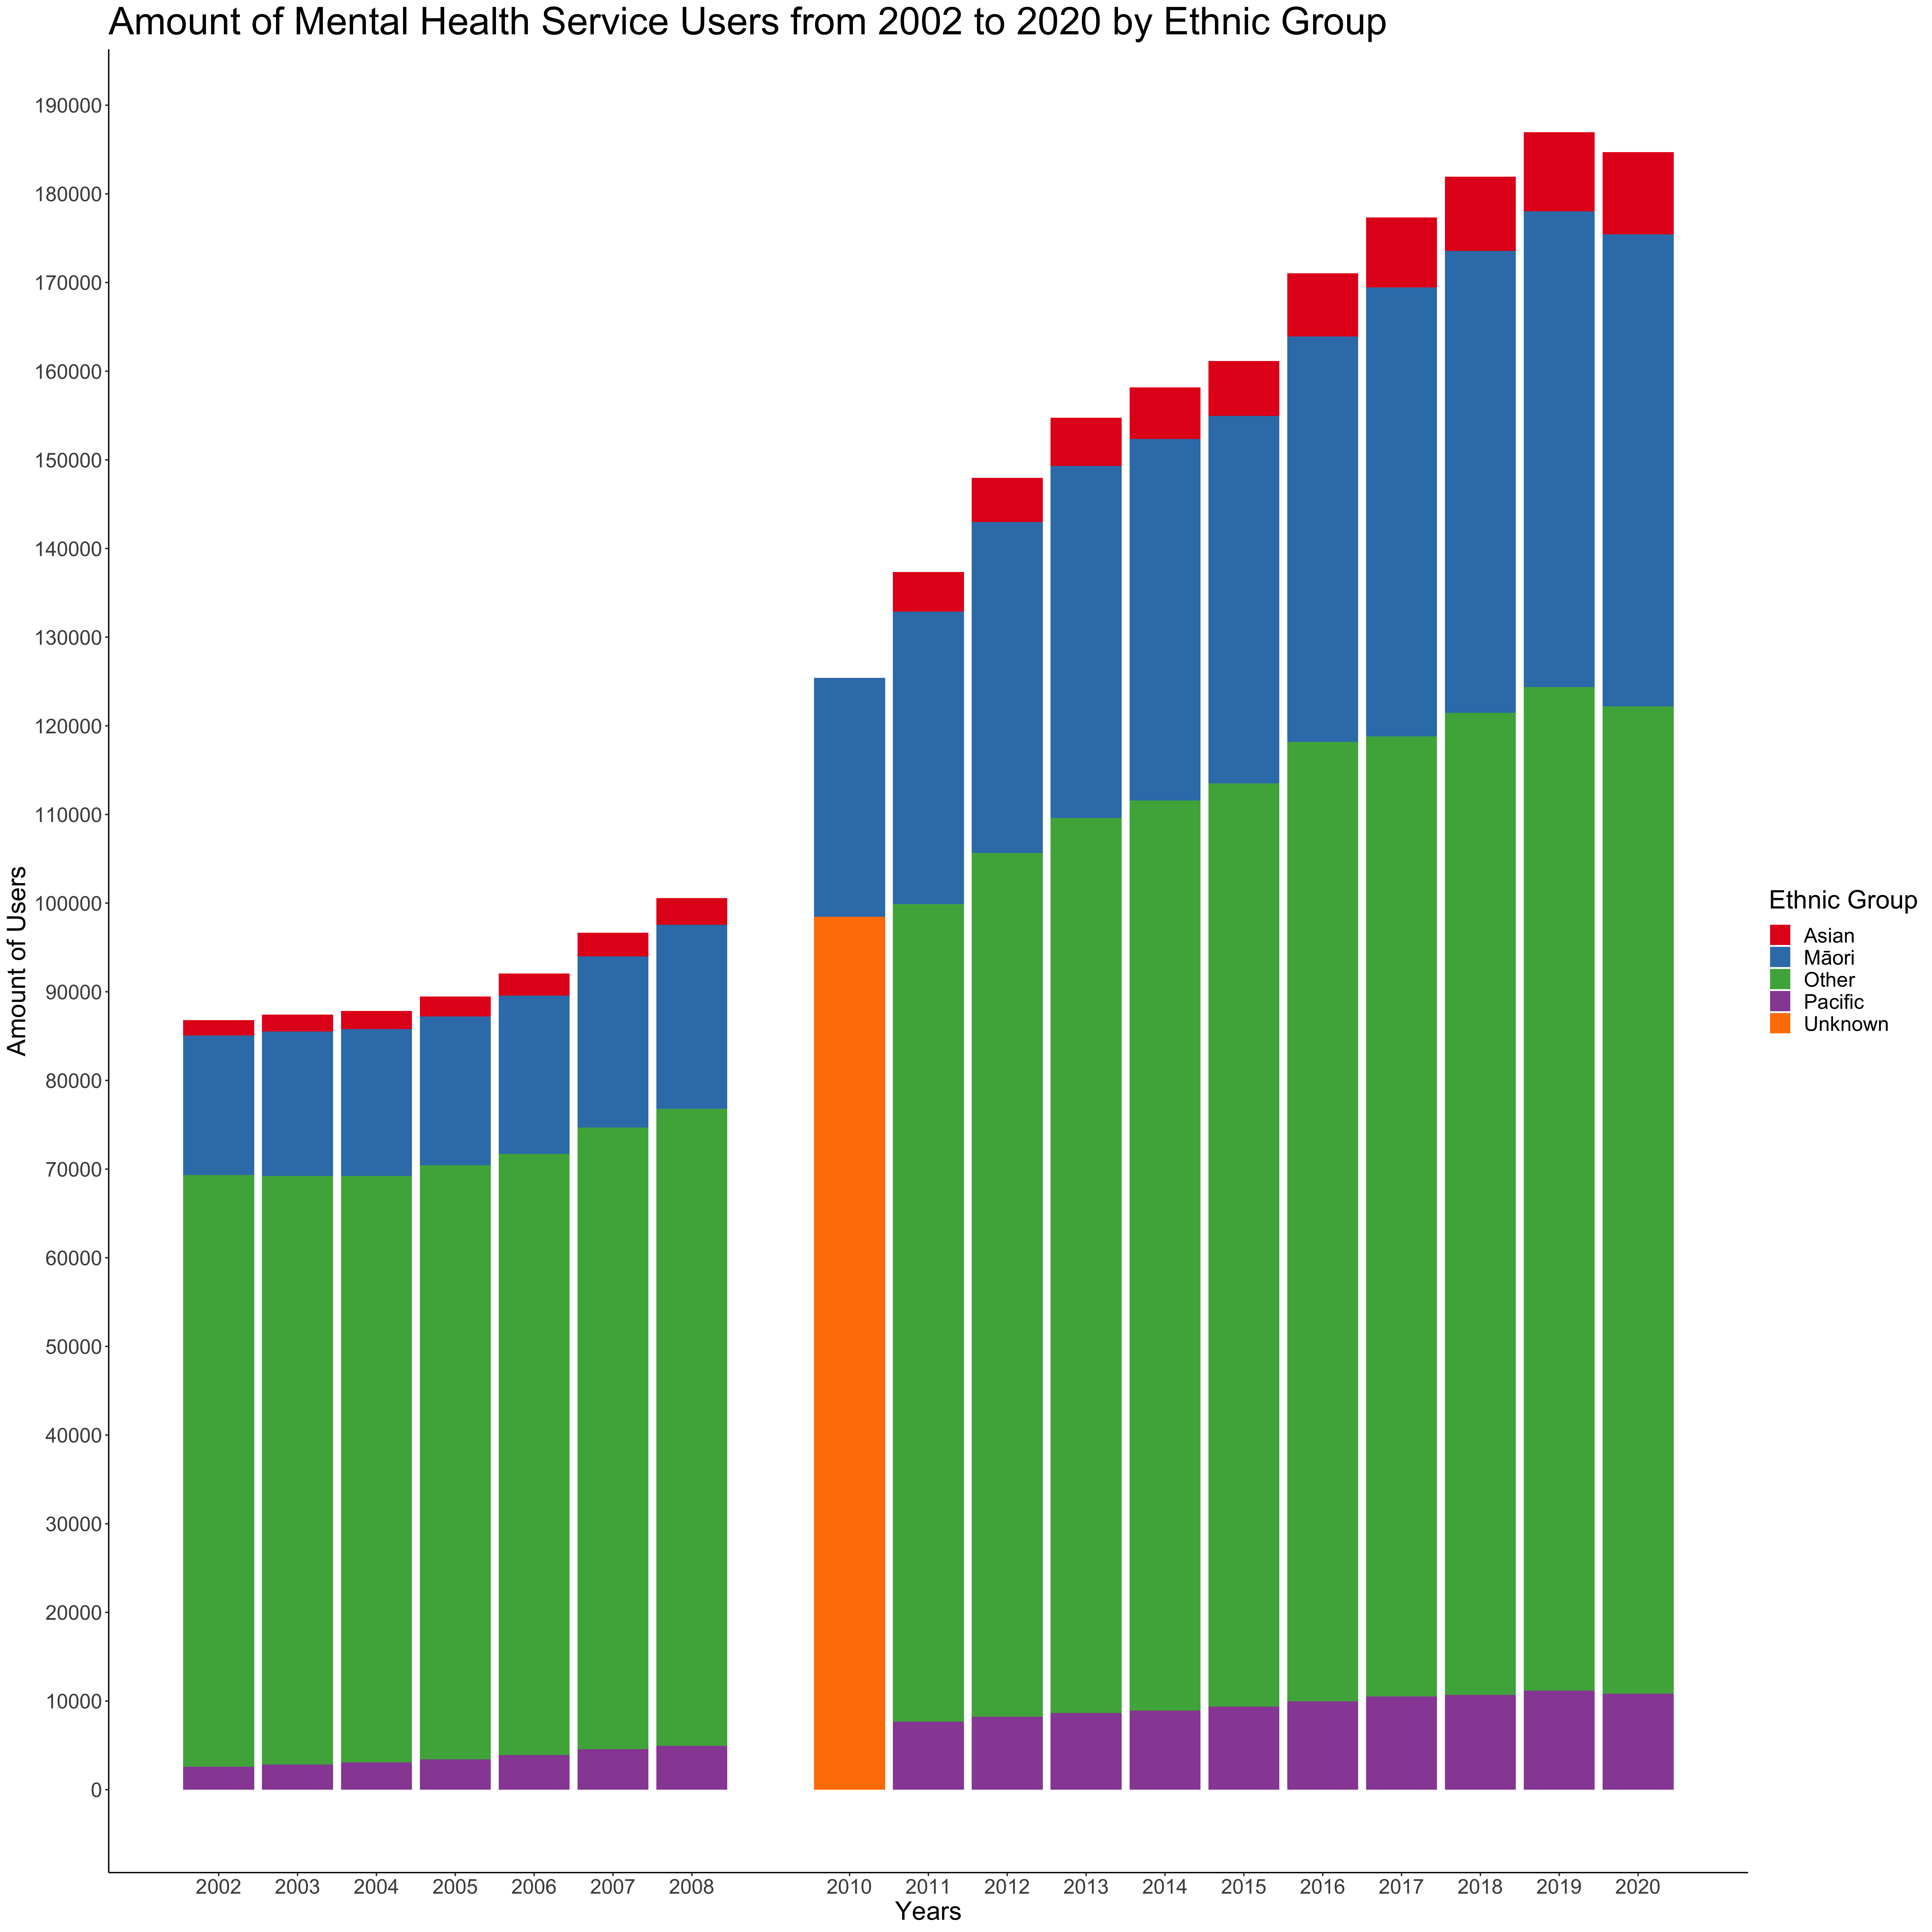

Slide 18
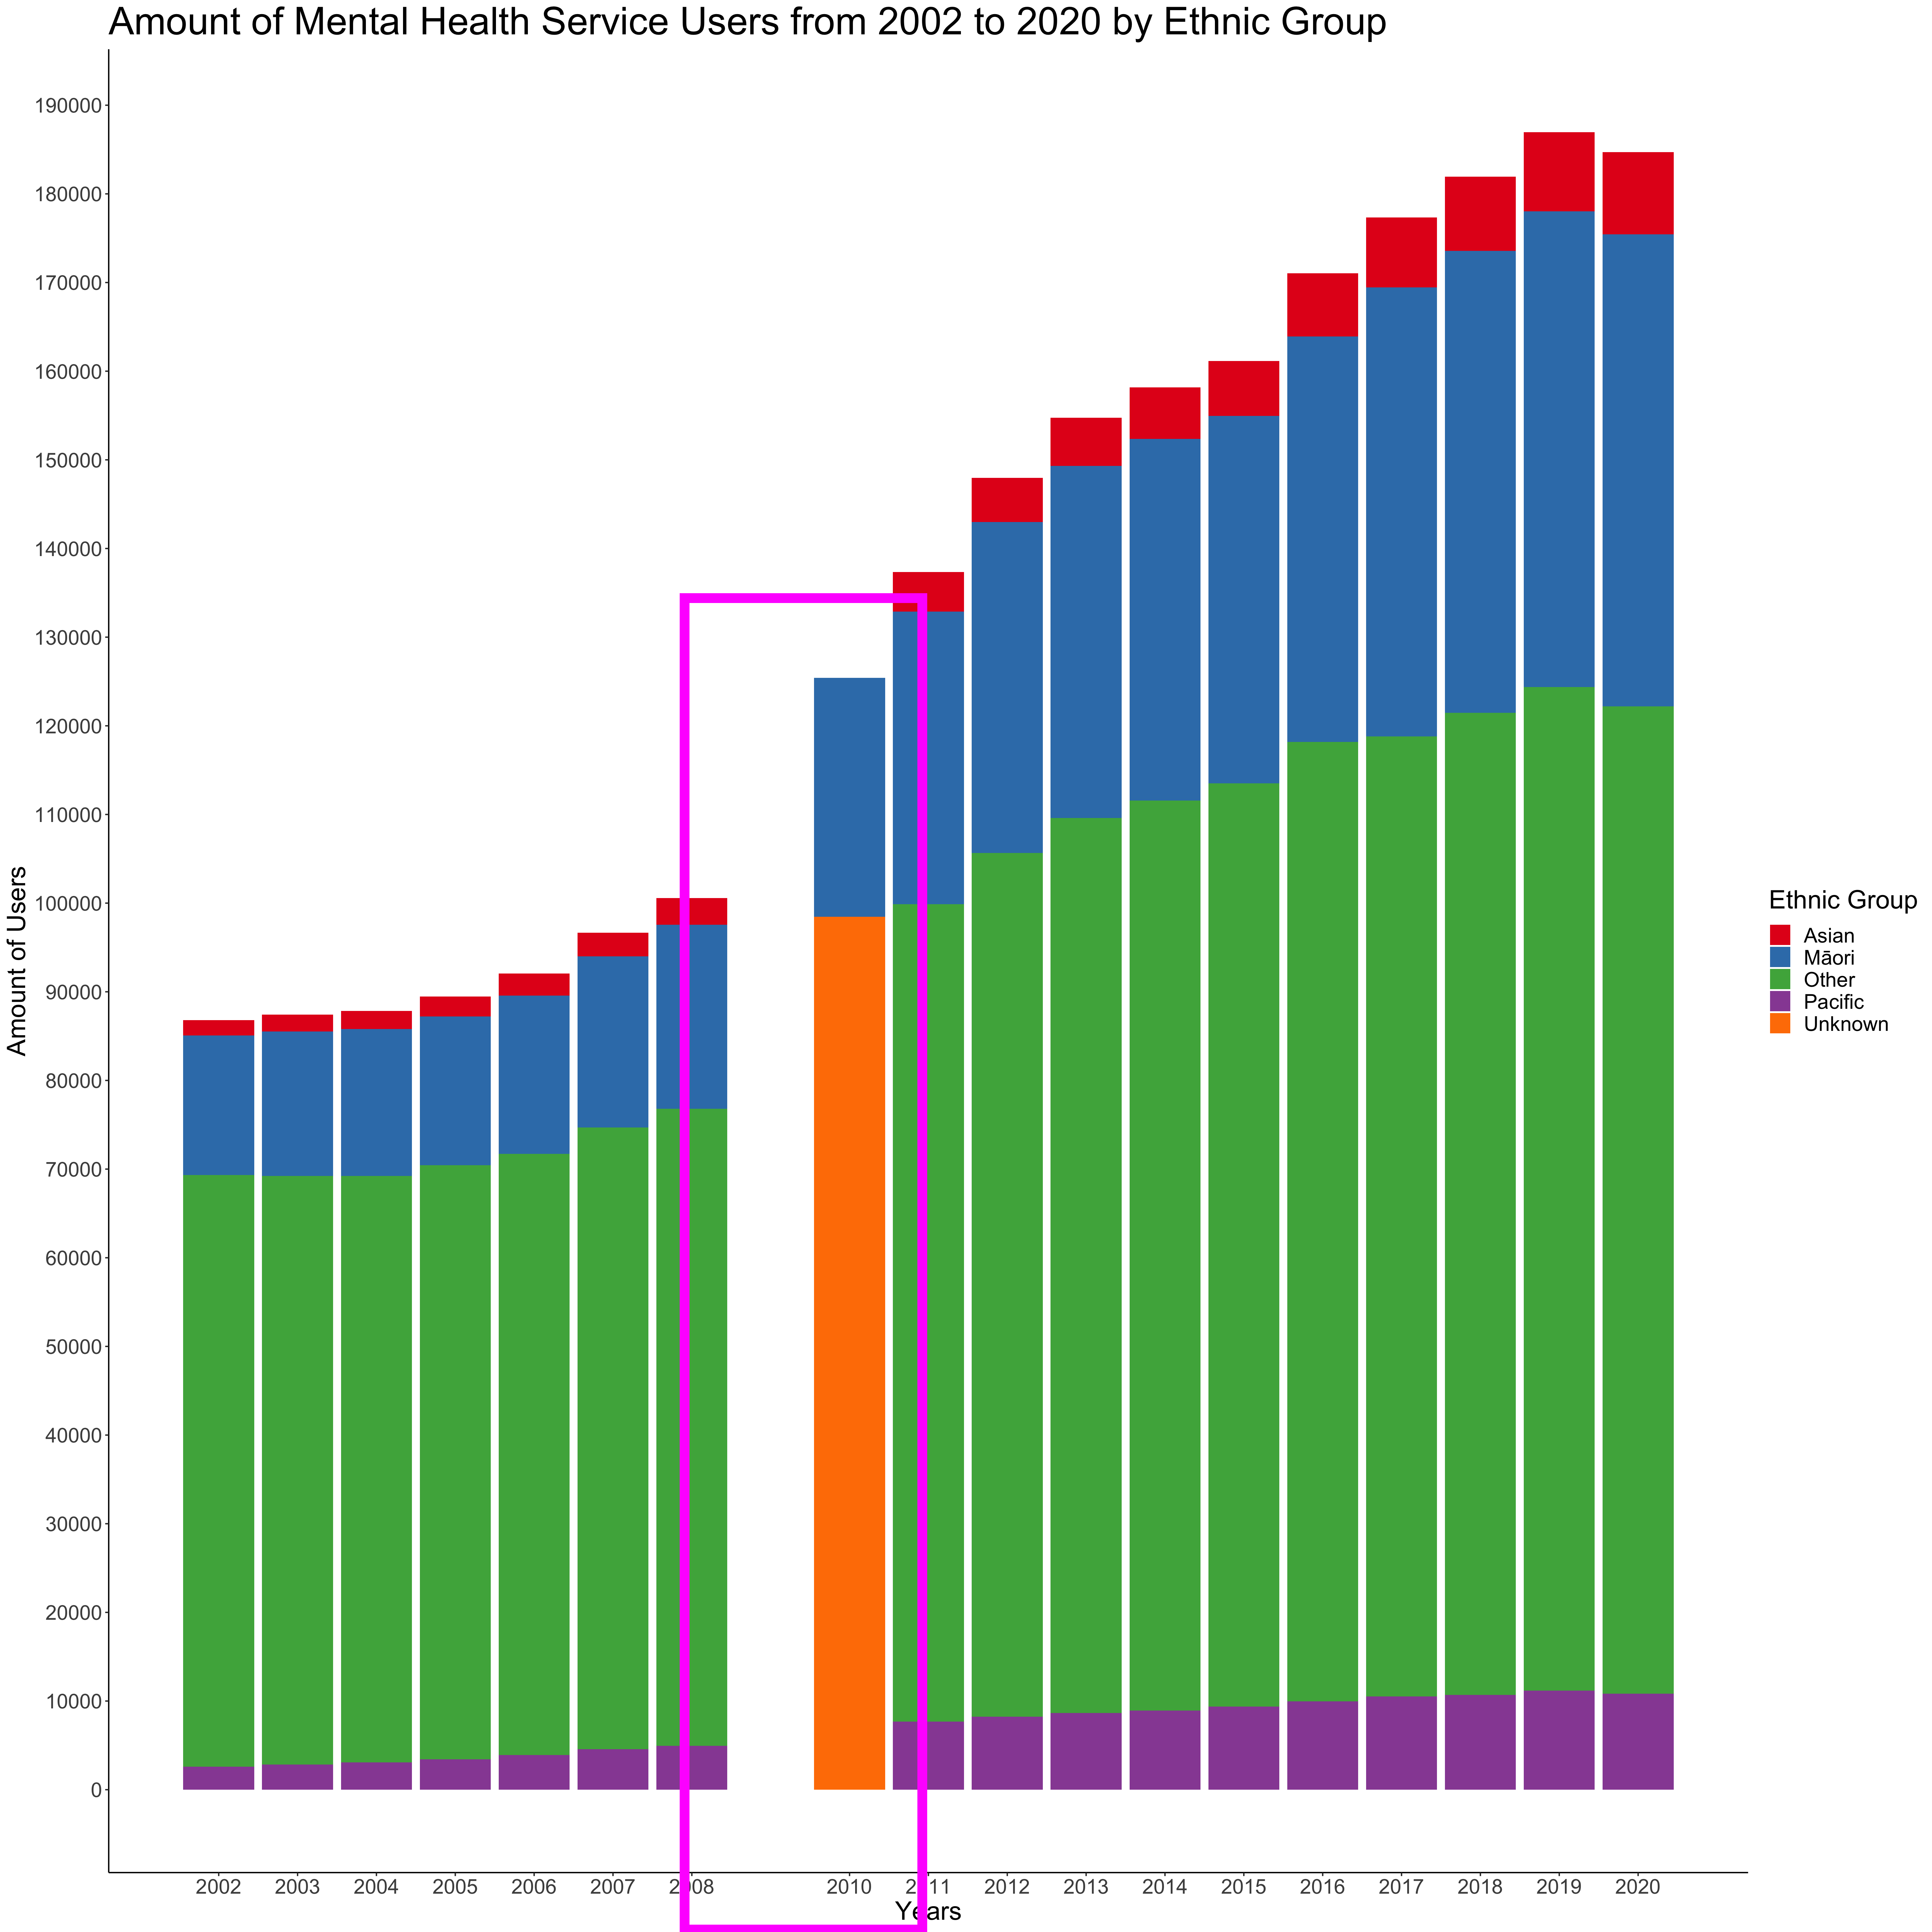

Slide 19
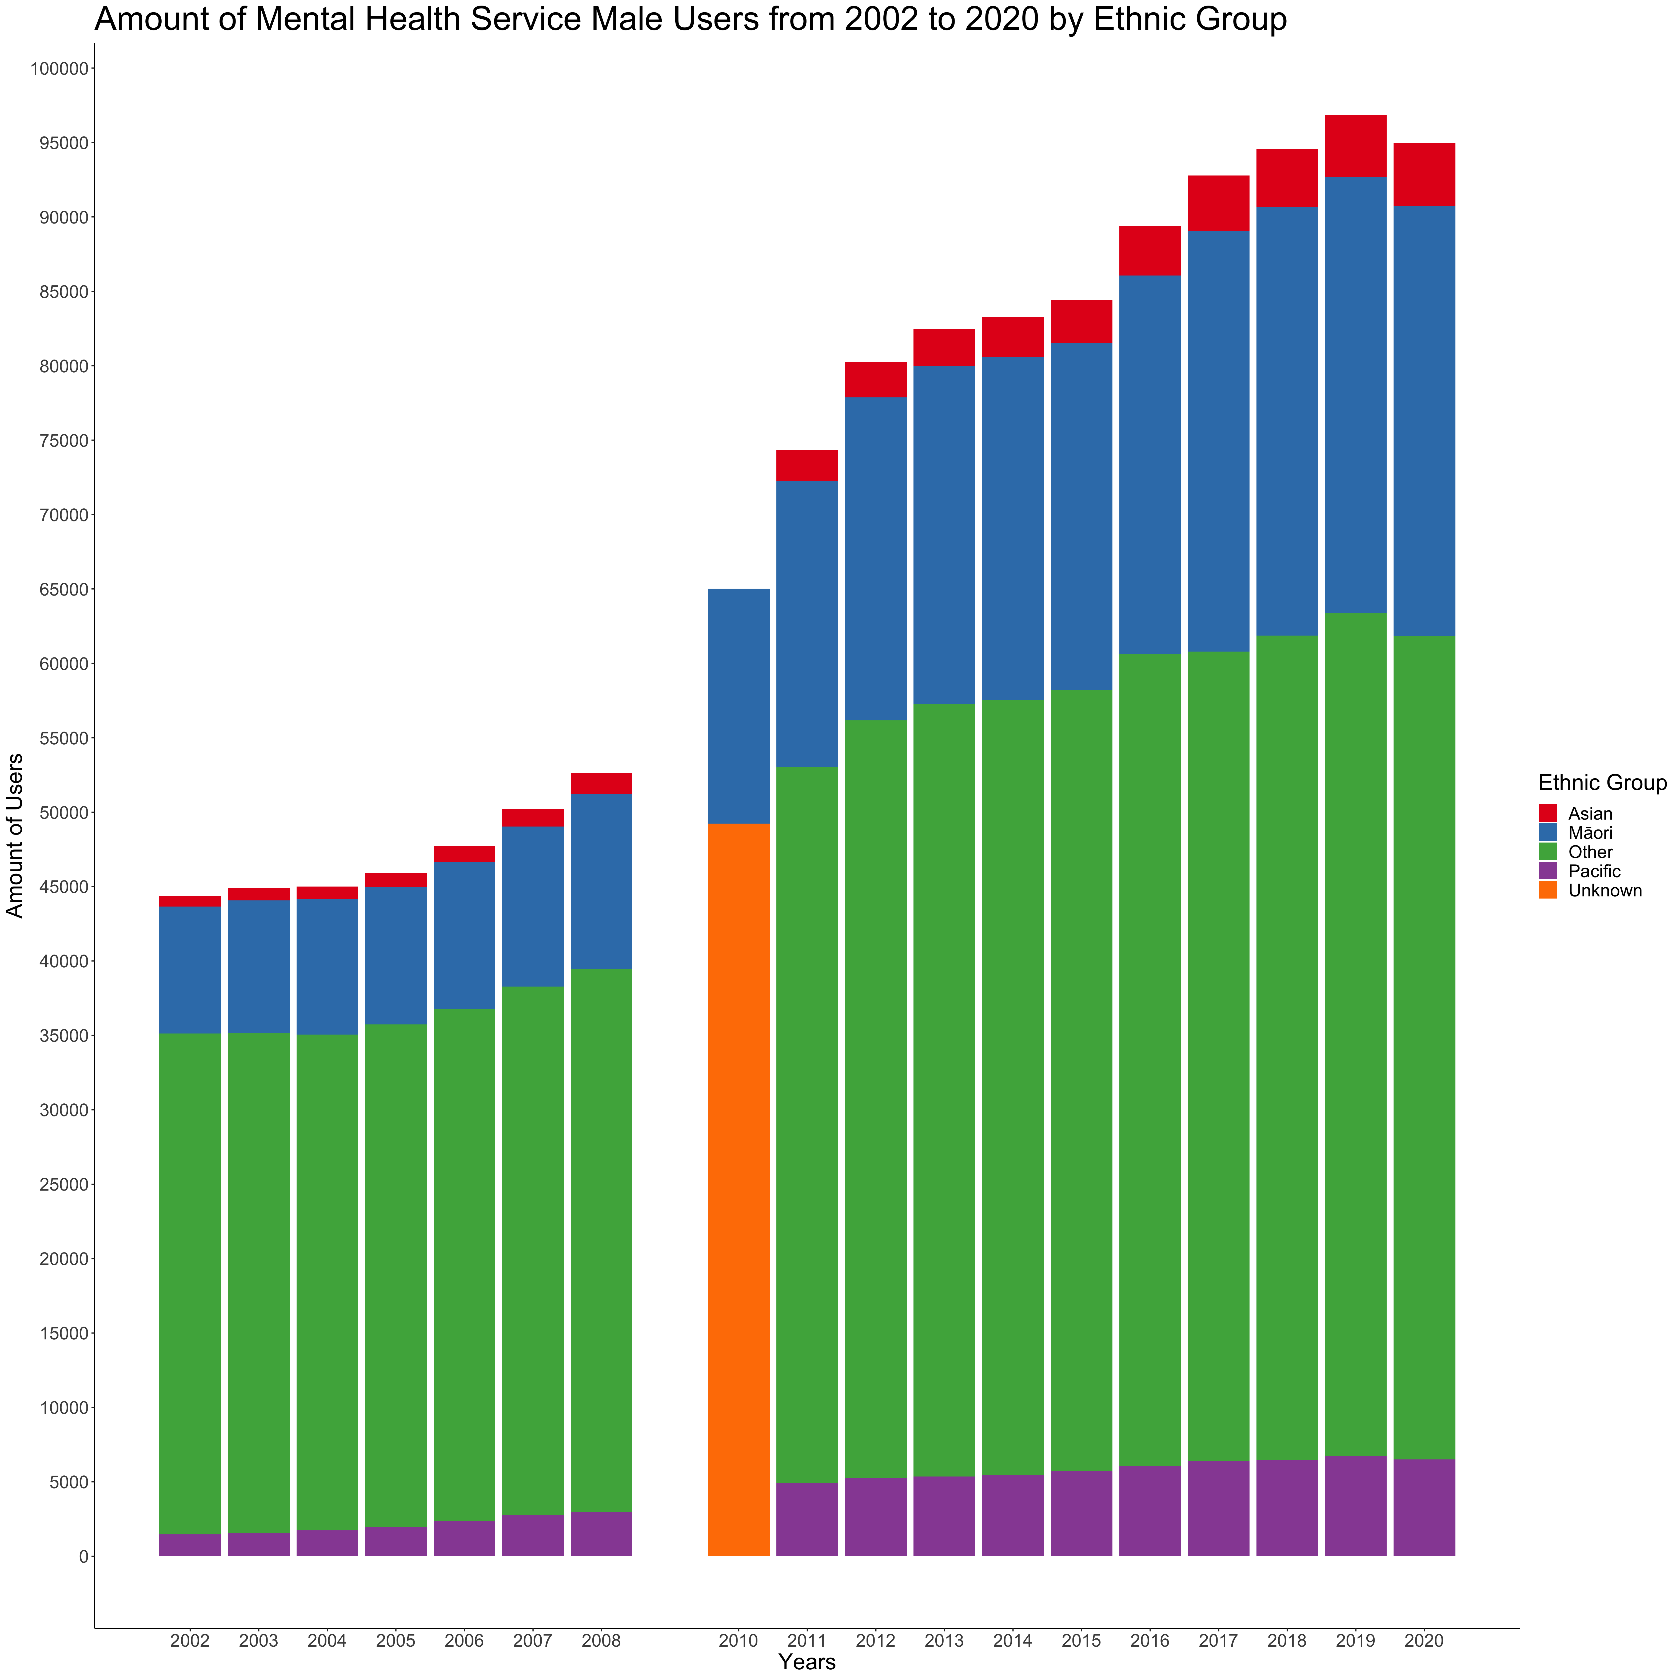

Slide 20
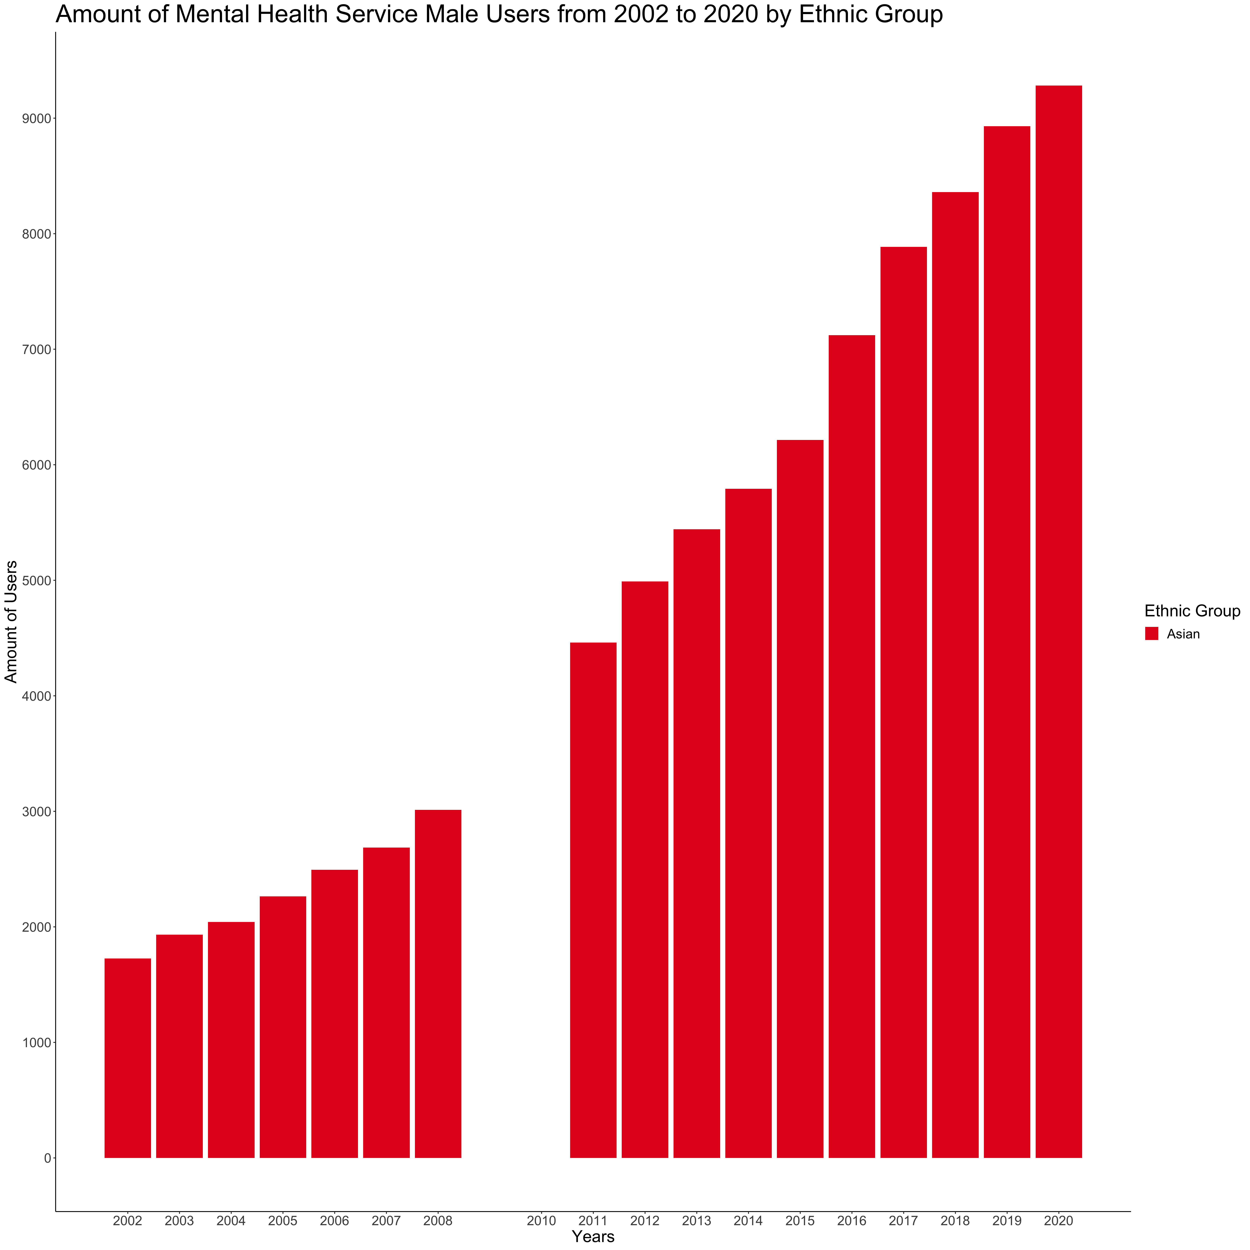

Slide 21
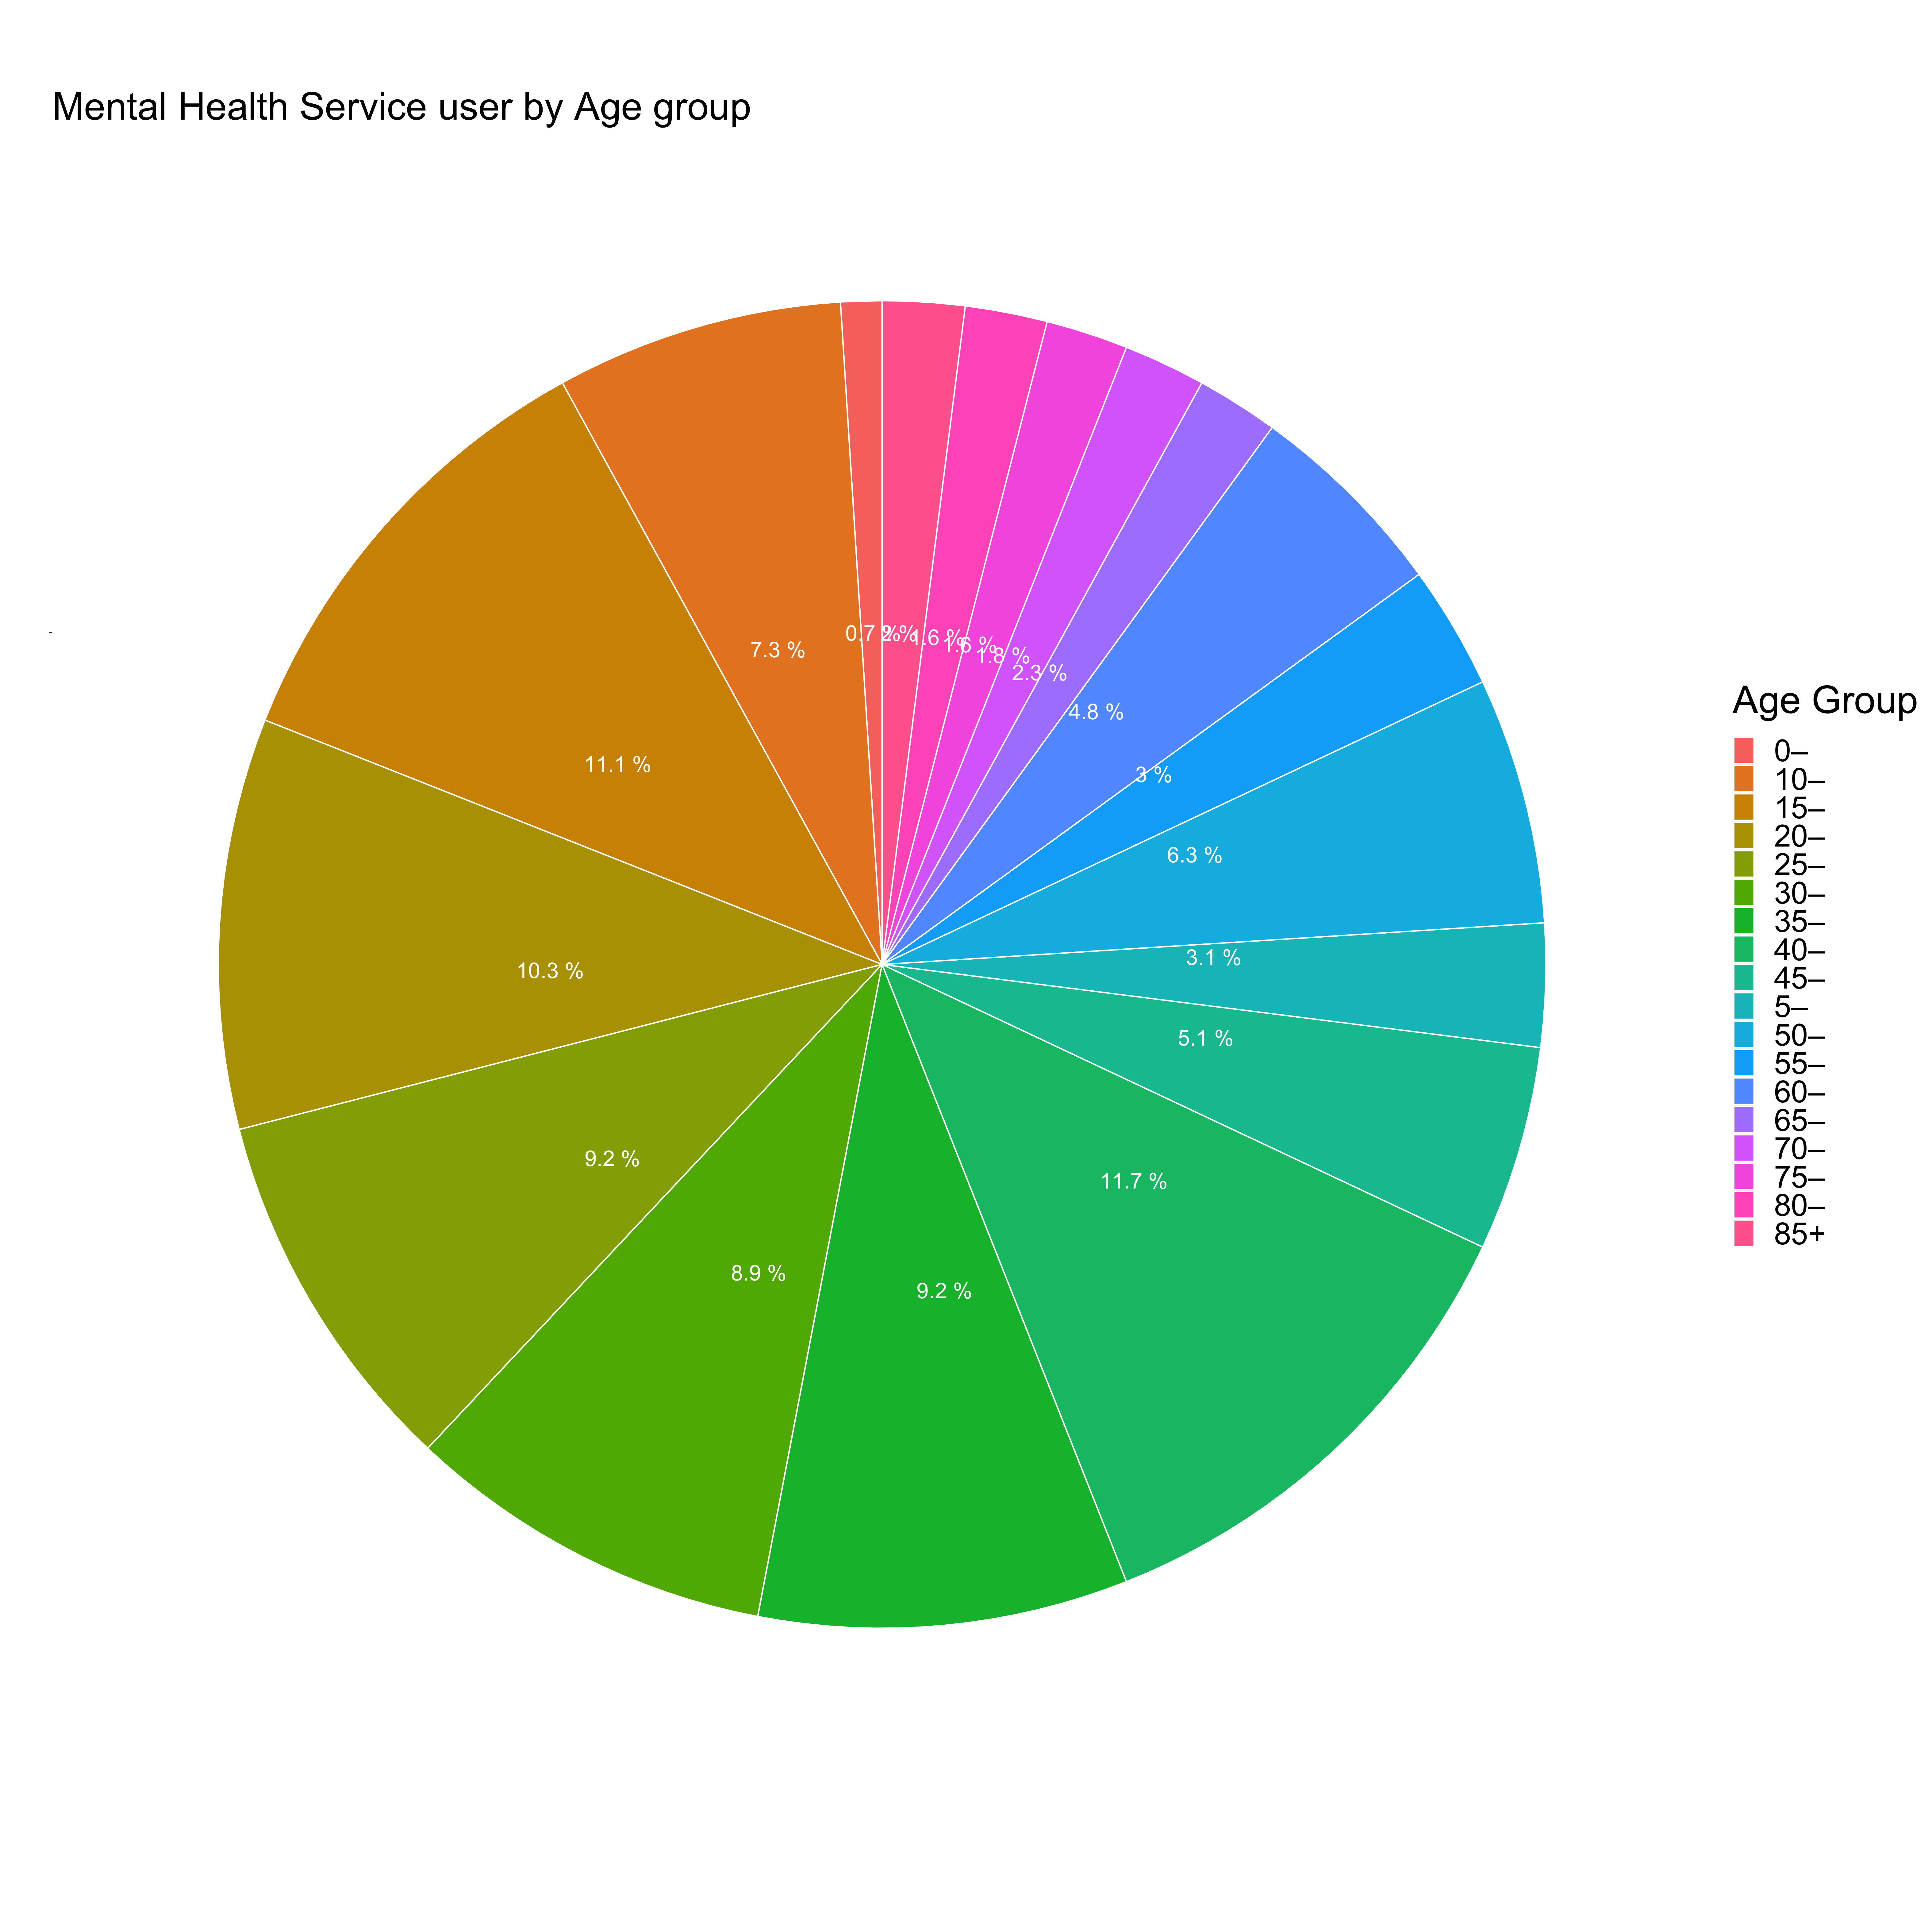

Slide 22
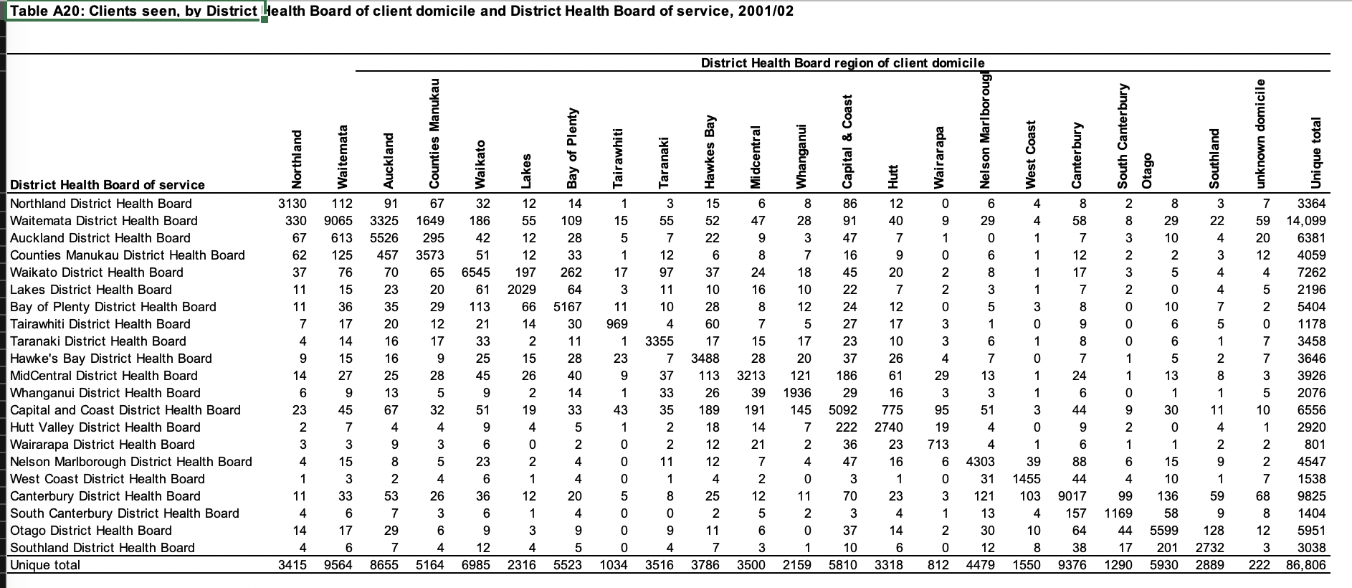
DHB Usage Information

Slide 23
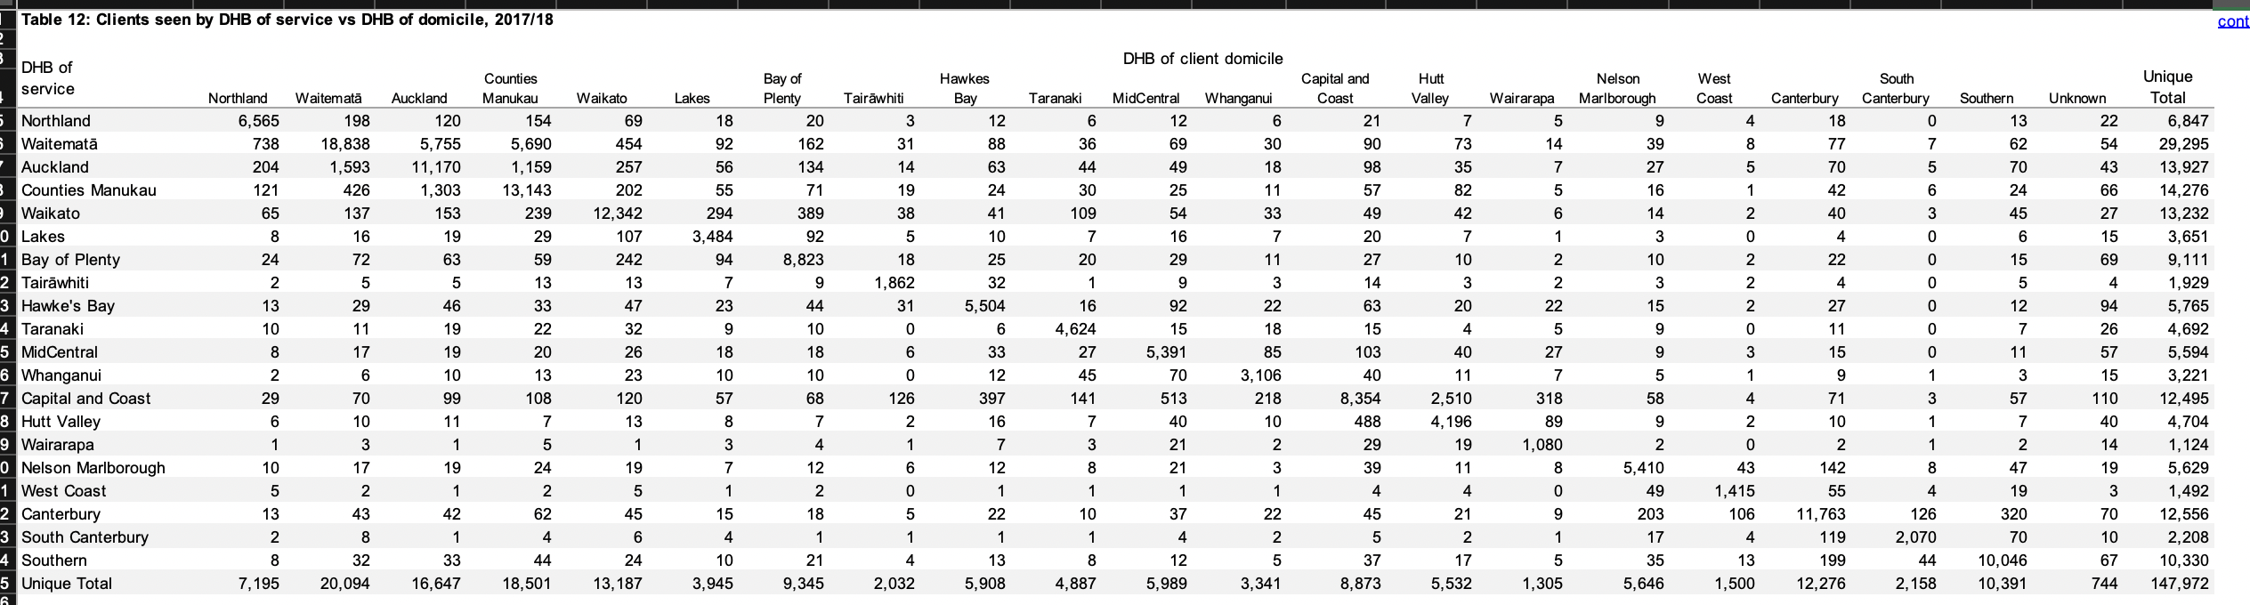
DHB Usage Information

Slide 24

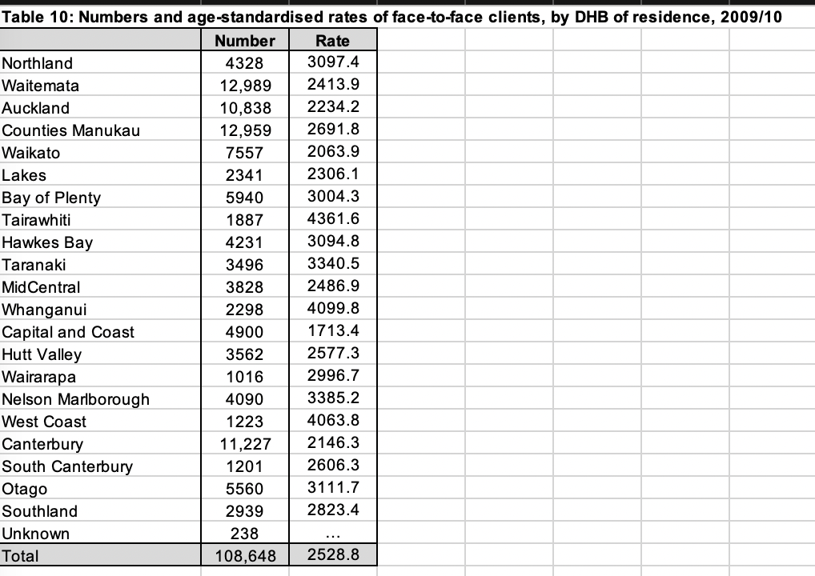


DHB Usage Information

Slide 25
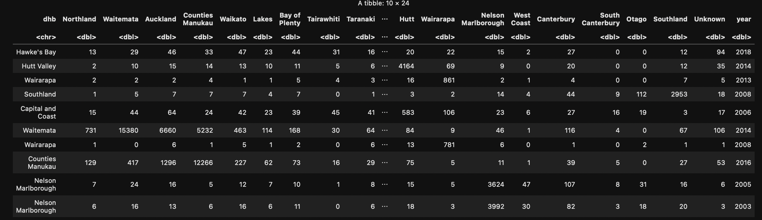
Our Data Frame.

Slide 26
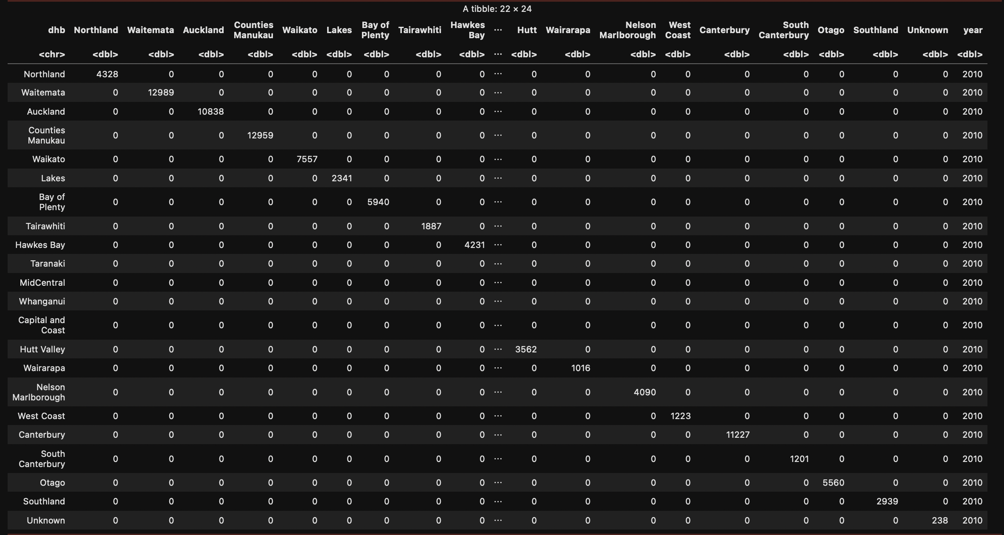
A little trick to solve the last slide.

Slide 27
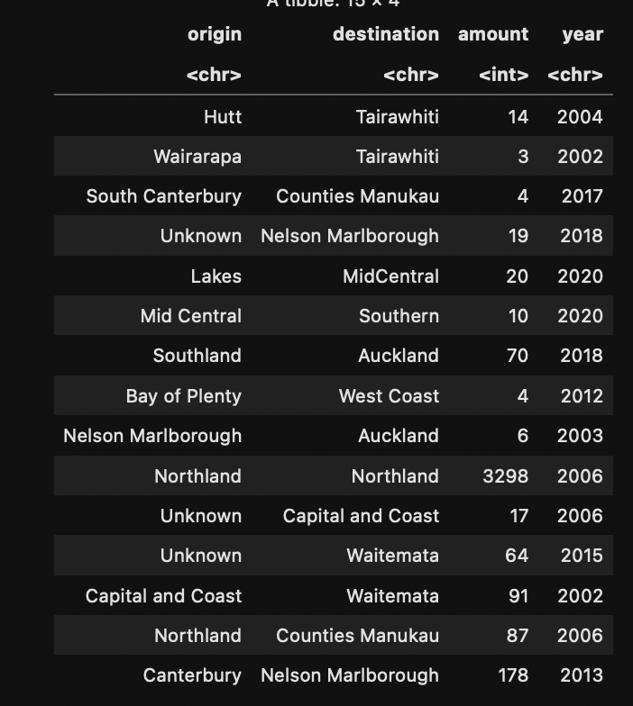
Long Format.

Slide 28
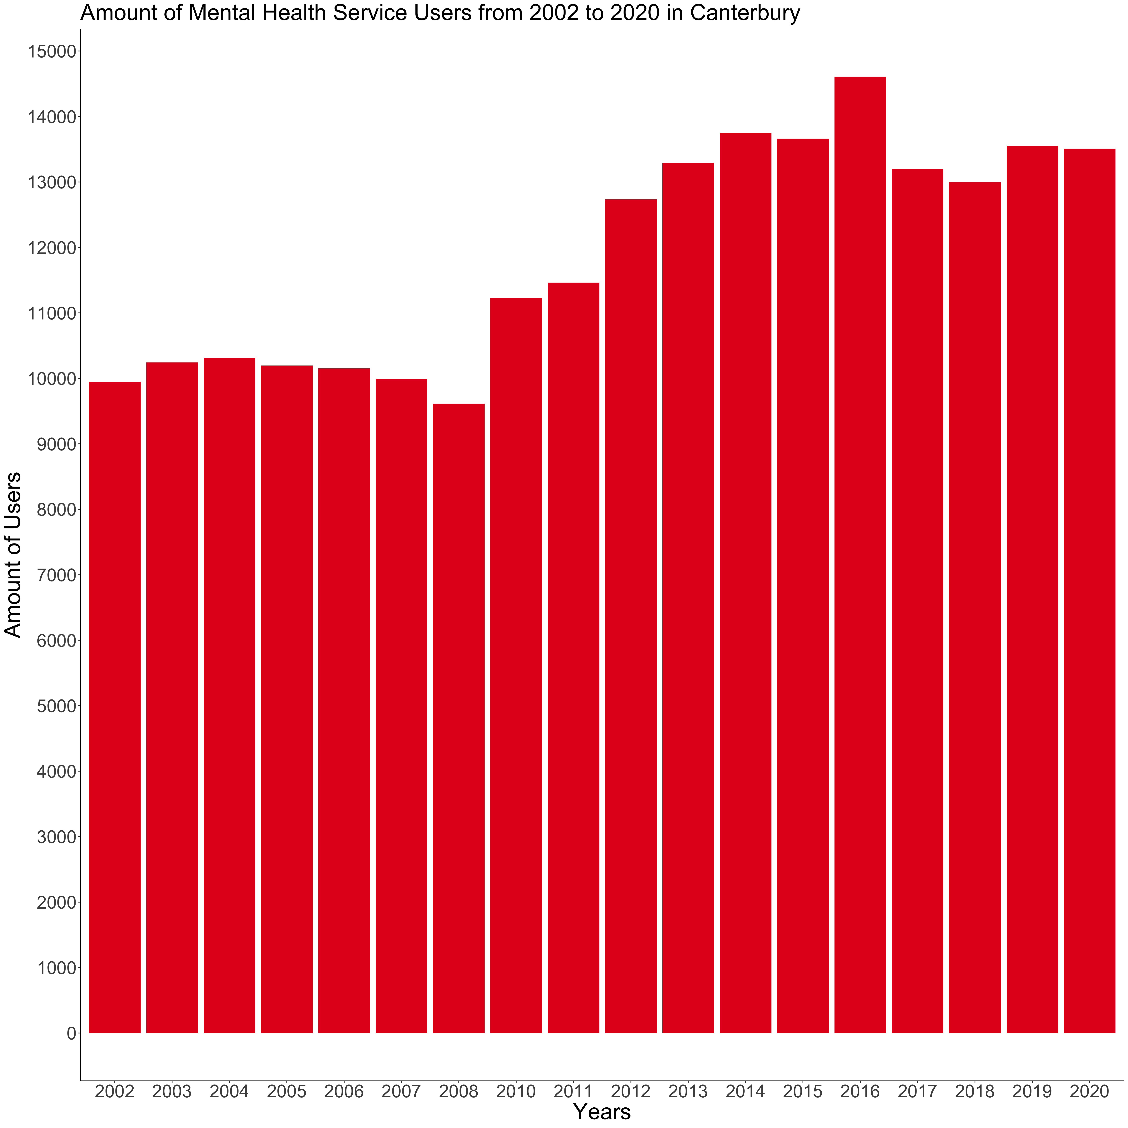

Slide 29
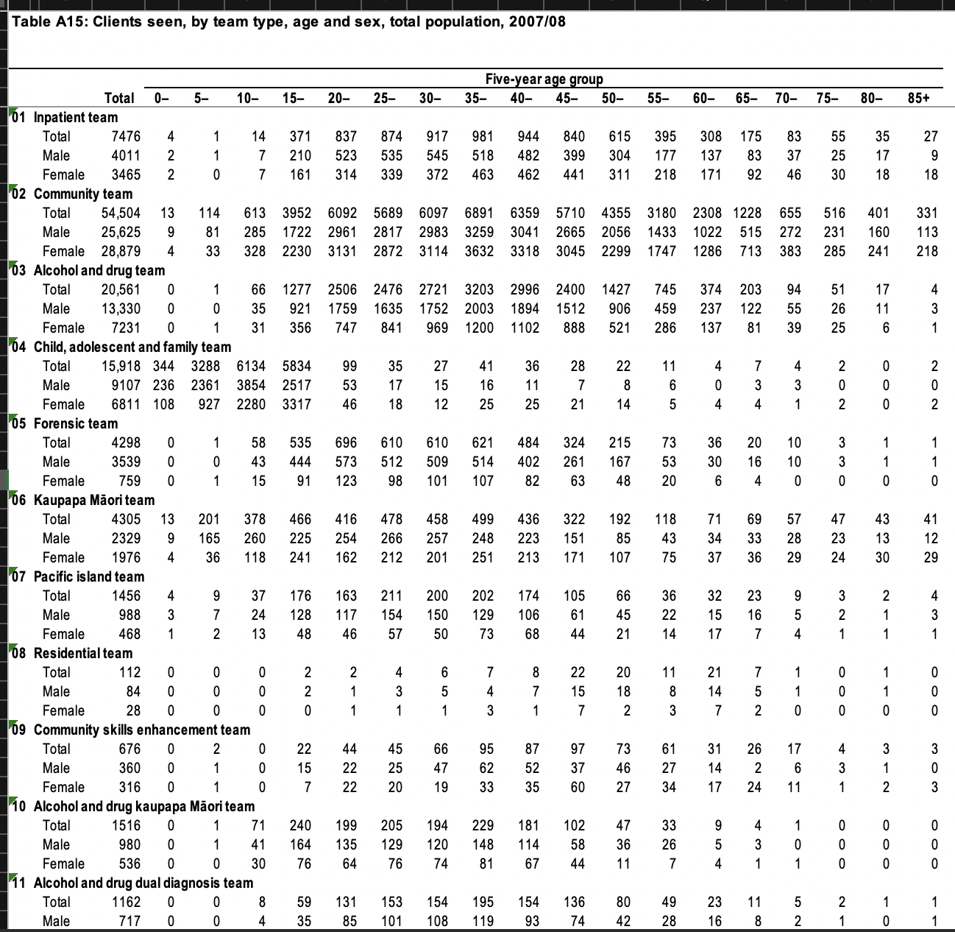
Users by Service.

Slide 30
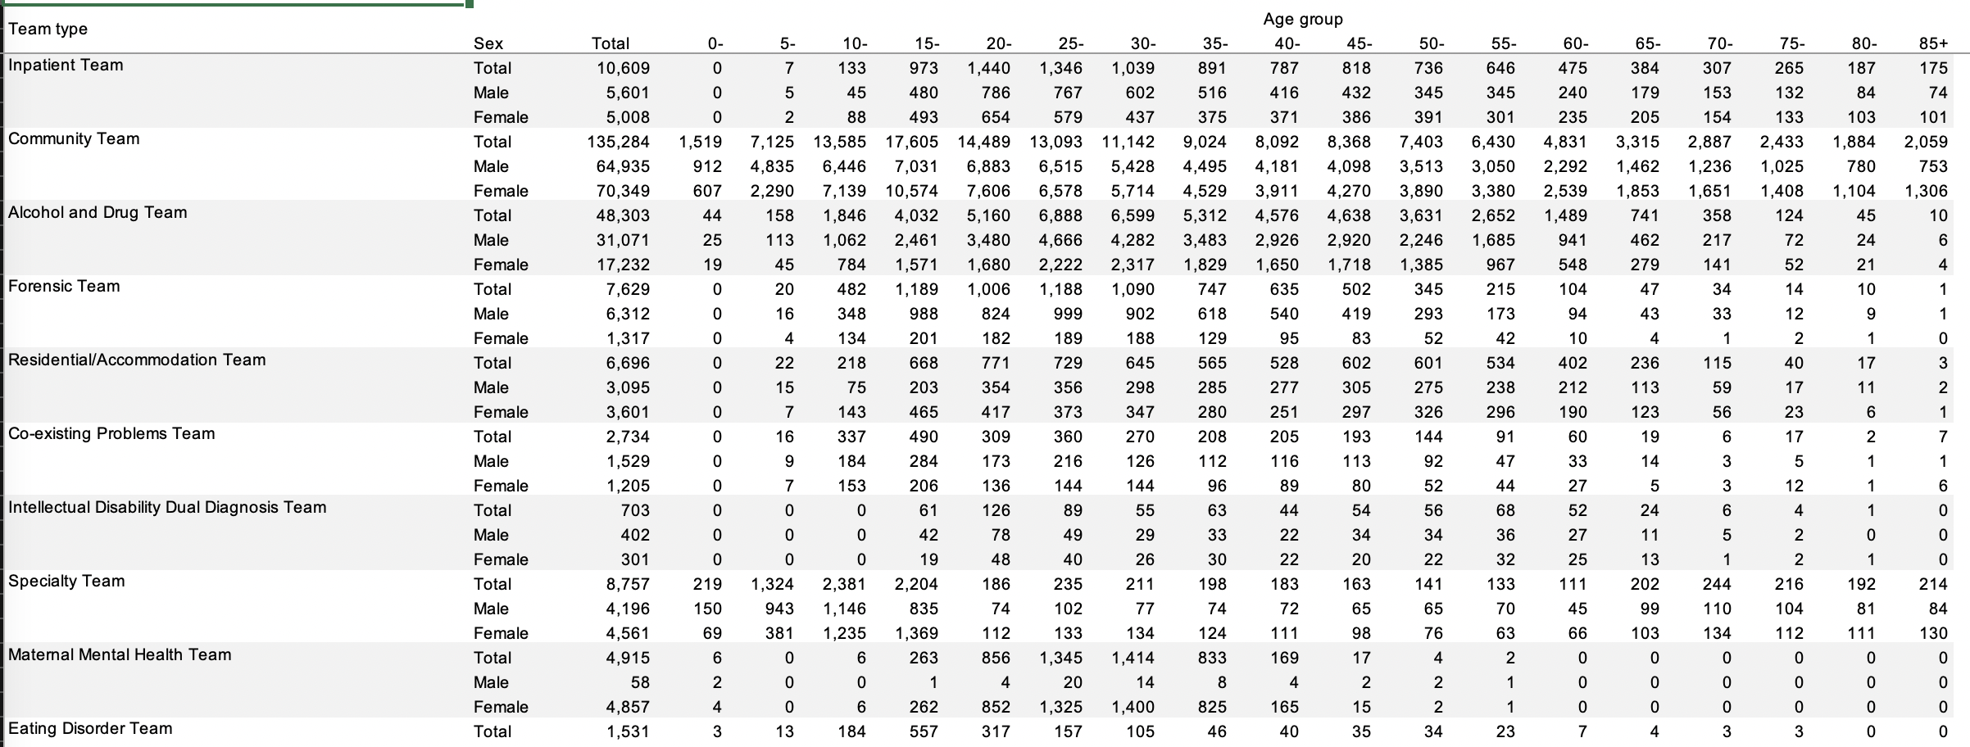
Users By Service 2.

Slide 31
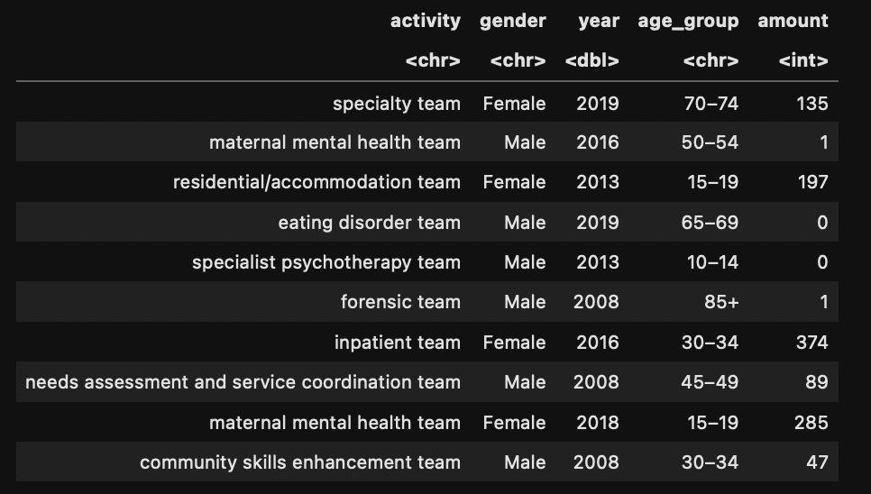
Long version.

Slide 32
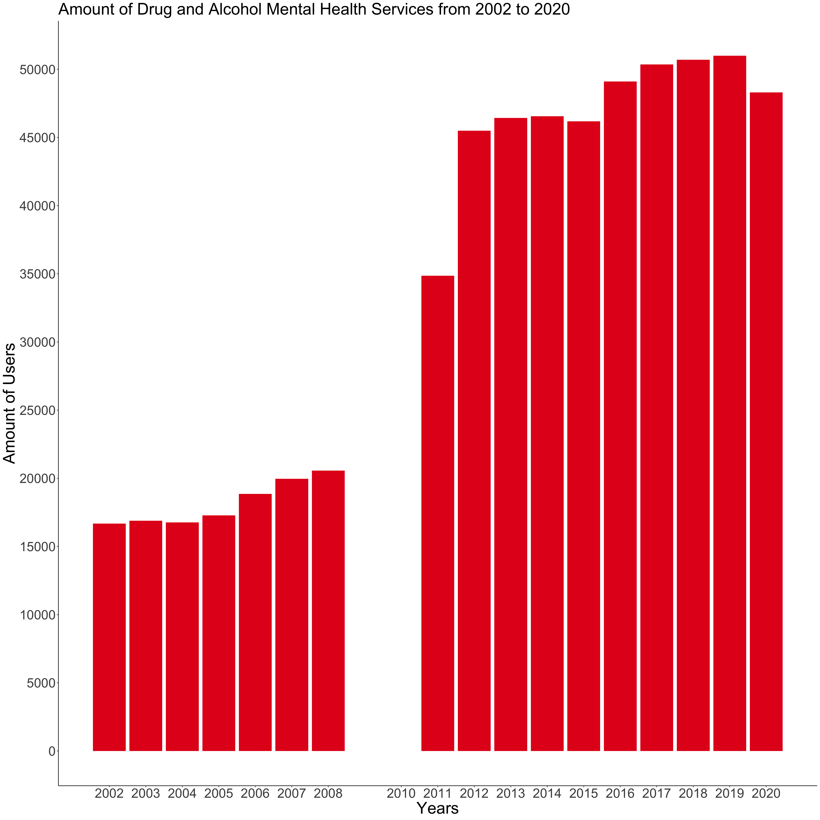

Slide 33

Thank you!
Questions?

